Slide 1

Machine Learning in the Real World - Life Cycle and Engineering Practice
Dr Fariborz Baghaei Naeini

Slide 2
My Journey
MSc Embedded Systems (2016-2017)
  Joint MSc project with Micrima Ltd Bristol
PhD: Neuromorphic Vision-based Tactile Sensor (2017-2020)
  Supervisory Team: Prof Dimitrios Makris, Dr Yahya Zweiri
  Summer school BMVC (2017)
  Game-Theory Group
  Graduate Teaching Assistant
  Joined Ipsotek (2018)
  Currently AI Product Manager at Ipsotek (an Atos Company)

Slide 3
ML can do everything but
87% of ML Projects Fail (VentureBeat 2019)
Why?

Slide 4
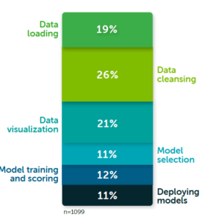
Machine Learning is Data Driven!
Data scientists spend more than 65% of their time on data (2020):
Data is a new oil and valuable asset of each organisation
Data is the raw and unprocessed facts, insight is gained by analysing data
Raw data
Data scientist
Processed data
Data engineer
Data scientist
Train AI
ML engineer
Source: https://www.datanami.com/2020/07/06/data-prep-still-dominates-data-scientists-time-survey-finds/)

Slide 5
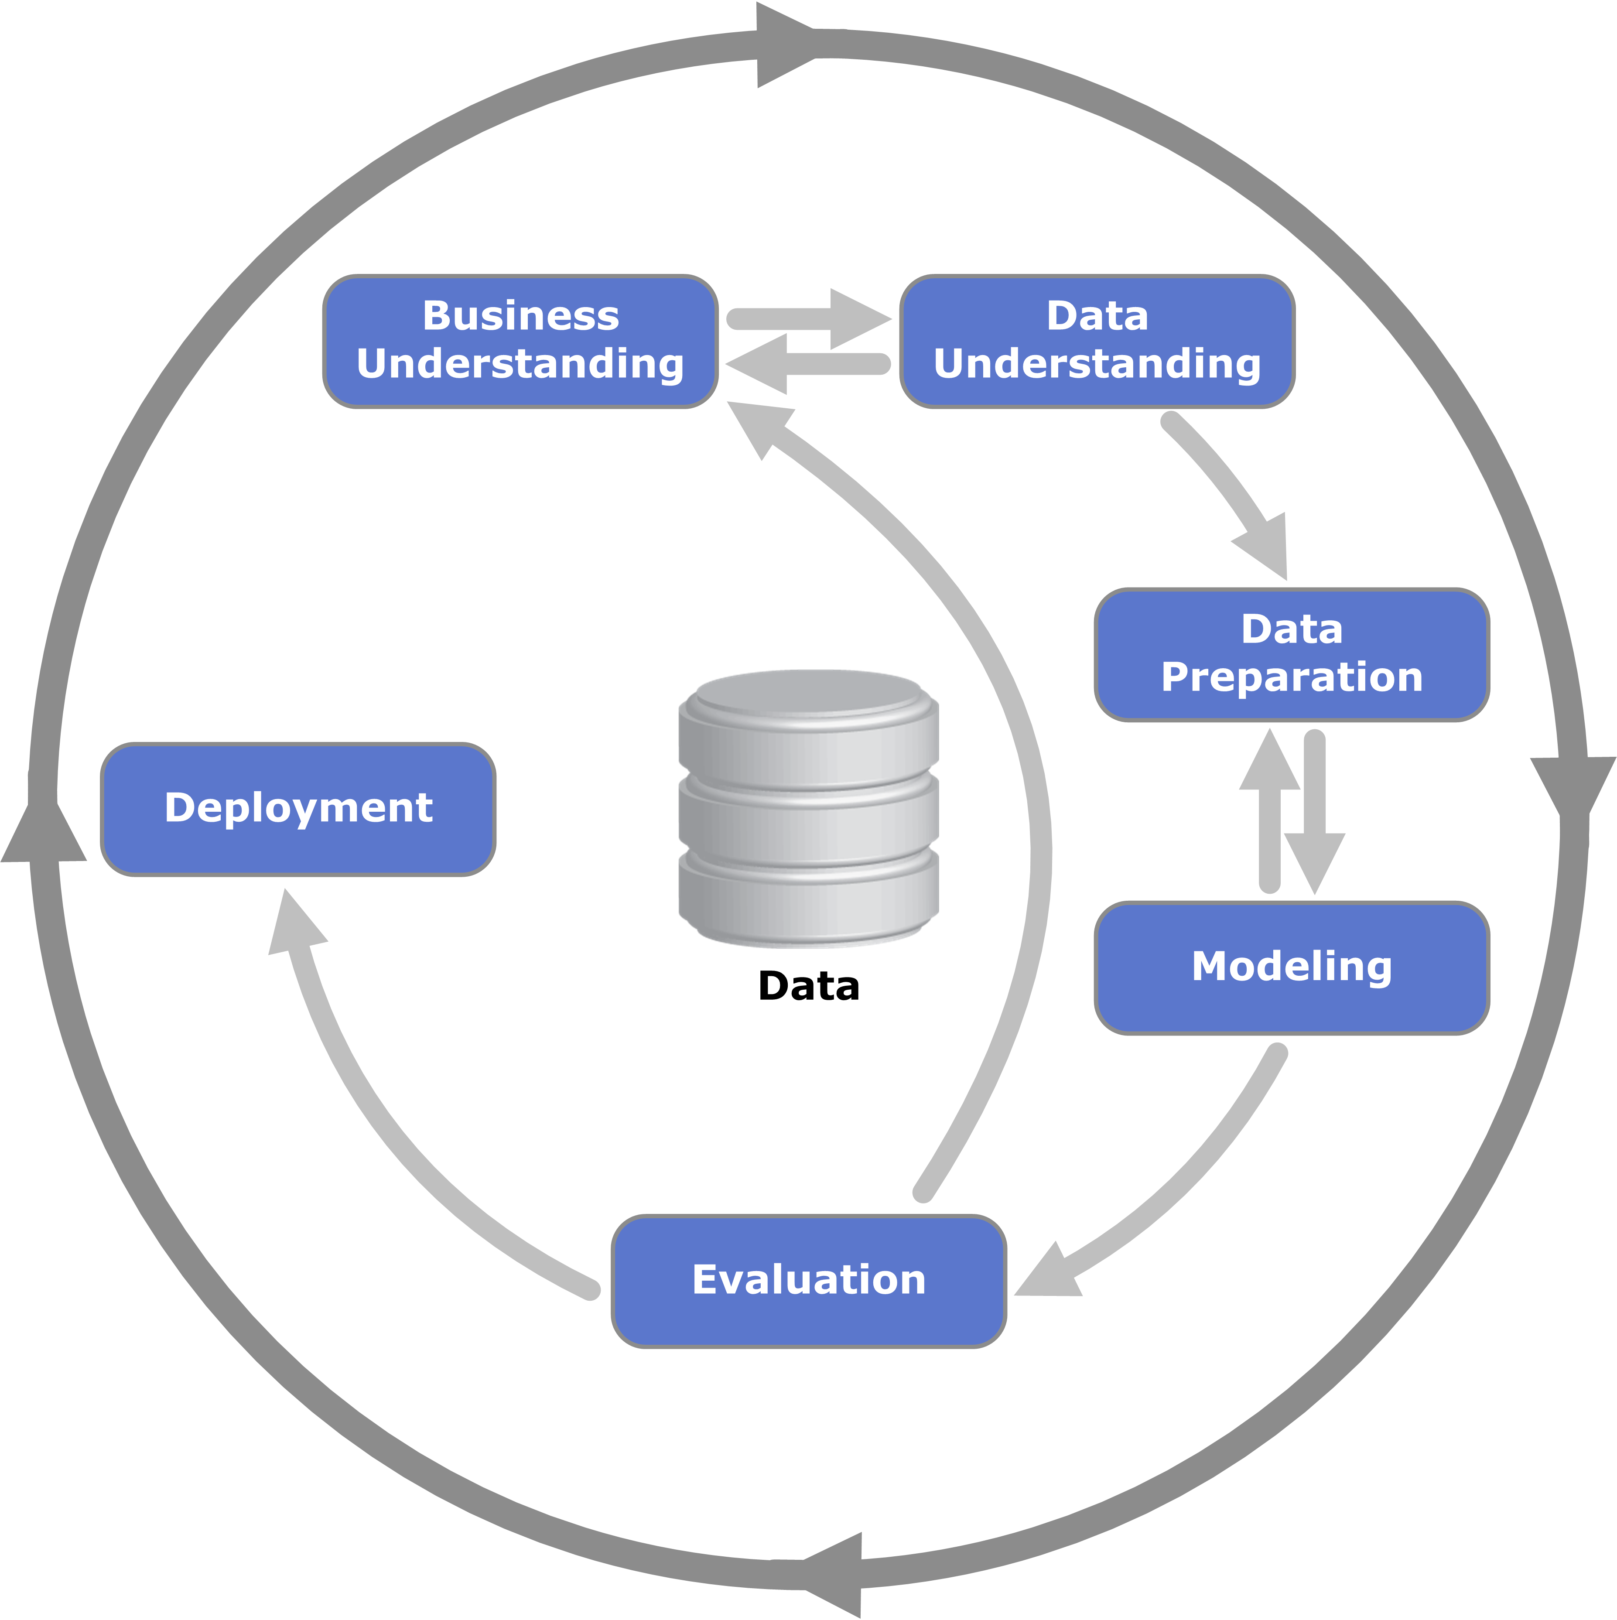
Machine Learning Life Cycle
CRISP/DM
Cross-Industry Standard Process for Data Mining
(CRISP-DM)

Slide 6
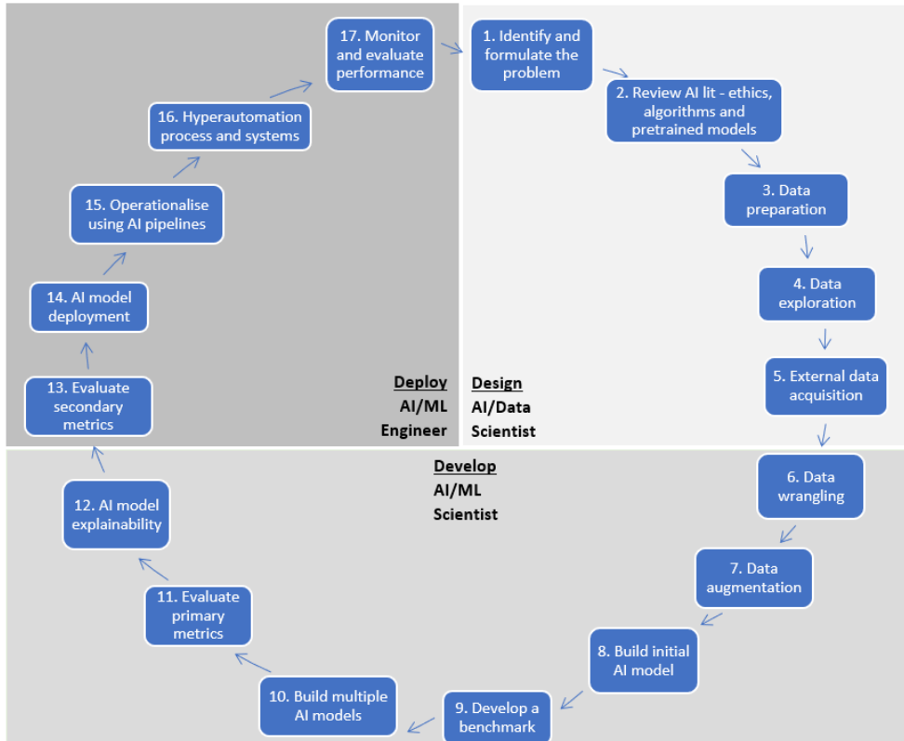
The CDAC AI Life Cycle
Centre for Data Analytics and Cognition

Slide 7

Project scoping and Business understanding
Project Scoping:
How many models do you need?
How much occlusion do you expect?
Light conditions?
Dynamics in the project environment?
What is the expectation accuracy?
Can this problem be solved by other methods?
Is there any recorded data for the project?
What is the minimum required resolution?

Slide 8

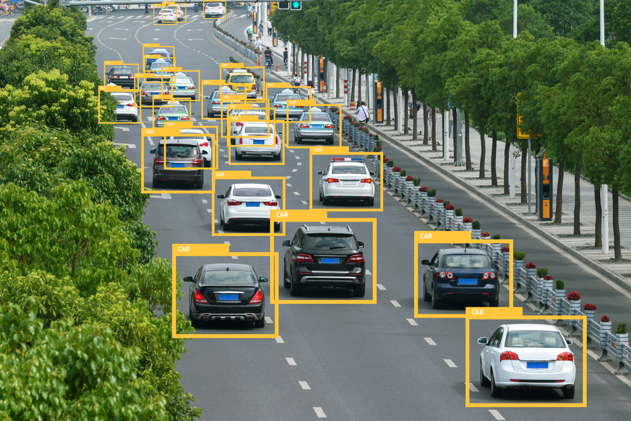
Data strategy , Data collection, Pre-processing and Labelling
Strategy:
How/When to collect data?
How long does it take?
Cost?
Quality of images and camera configurations?
What are the external factors?
How to increase data diversity?
Possible Biases in the scene/dataset
Processing
Data storage
Labelling by human

Slide 9
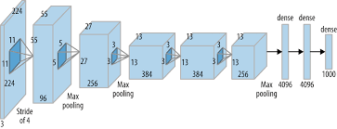
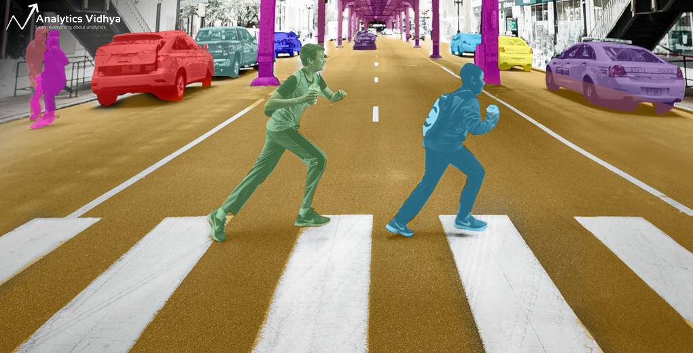

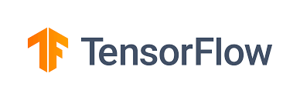
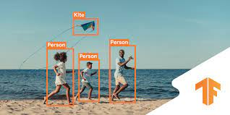
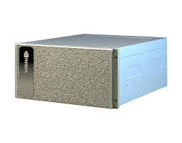
Algorithm Design and Training
How to approach the problem?
Detection
Segmentation
Anomaly recognition
Key-point recognition
Model Architecture
Speed
Resolution
GPU power
Compatibility
Accuracy
Training on GPU Servers

Slide 10
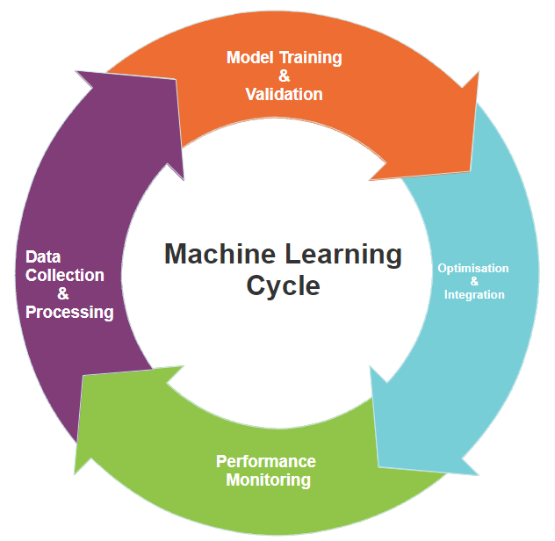
Model Validation and Performance Monitoring
Model Validation
Define metrics (accuracy, recall)
Test on unseen data
Insight from the results
Model Monitoring
Model aging
Data drift

Slide 11
Useful tools
Training:
Pytorch/Tensorflow
Albumentations
AutoAugment
Tensorboard
OpenCV/Pillow
Inference:
TensorRT/Torch
Model Pruning
Model Quantisation
Mainly C++/Java
TinyML/Vitis/
Useful Repos:
Detectron2
TorchRec
Segmentation Model
Pytorch-GAN
Acme (RL)

Slide 12
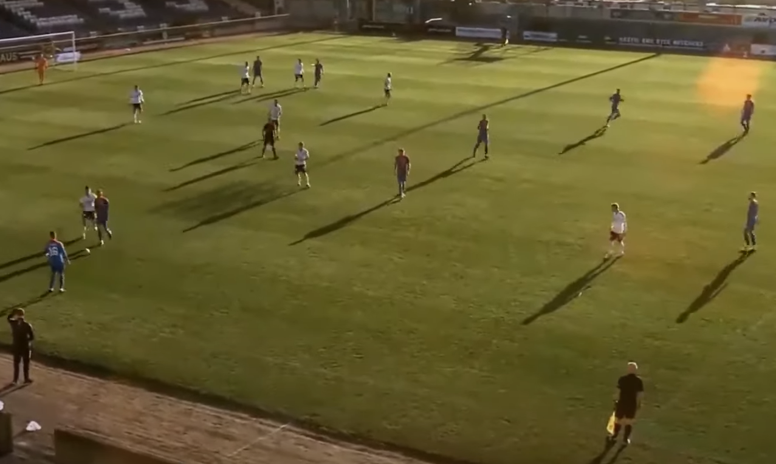
Be aware of AI failures
Tay Chatbot: Microsoft Corporation via Twitter on March 23, 2016 feeding it racist, homophobic, and sexist content that millions (attacked by fake comments)
Flickr: auto-recognition tool that identify some people as monkeys
Apple Face ID: First version of iPhone-X, a lot of reports of the recognition
Rekognition: Early tests on congress members and matched with criminals
Facebook: Identify a person as primate (2021)
Recruitment: Amazon 2015 AI was not gender neutral
Ball tracking system: detect referee head as ball
Source:https://towardsdatascience.com/5-ai-failures-you-probably-should-know-about-417ddebbc323

Slide 13
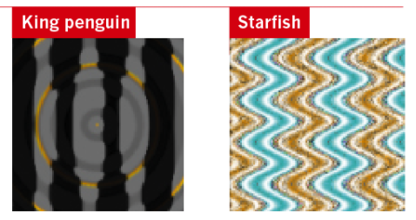
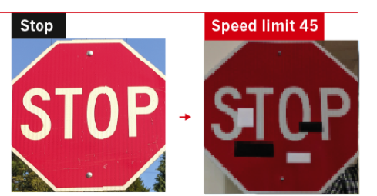
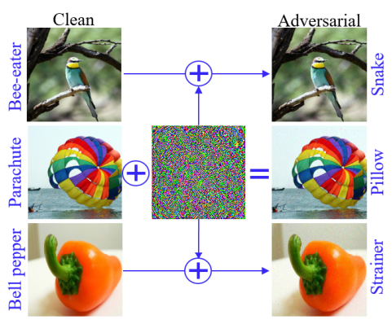
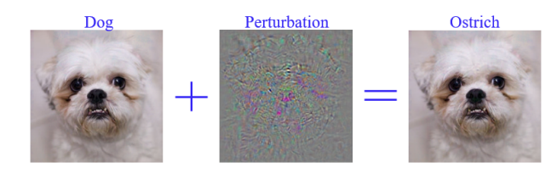
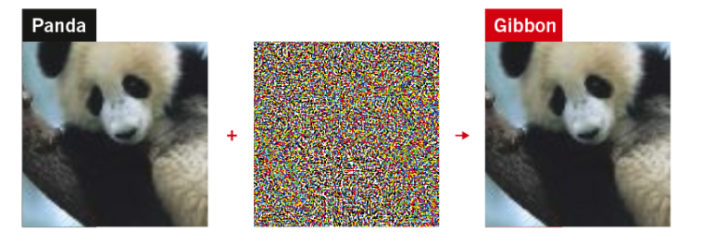
Adversarial Attacks:

Slide 14
Main factors for project failures in AI
Insufficient training data
Over-promising in project scoping
Poor data governance
Lack of explanation (black box)
Misalignment with business priorities
Architectural complexity (multiple models)
Talent: 74% increase in AI/ML jobs in last 4 years
Many models are not efficient yet to be deployed everywhere

Slide 15
Main Research and Applications Trends
Transformers and CNN + Transformers Architecture
Knowledge Distillation
Domain Adaptation
Multi-task Learning
Generative Adversarial Networks
Explainable AI
Transfer Learning
Federated Learning
Fully Homomorphic encryption for training

Slide 16
Some advises to prepare yourself for industry
Contribute to Open Source projects in GitHub
Learn coding standards and libraries
Code Versioning and software build workflow
Attend in hackathons and competitions (Kaggle)
Track requirements of jobs in different industries
Try to invest on building a complete application

Slide 17
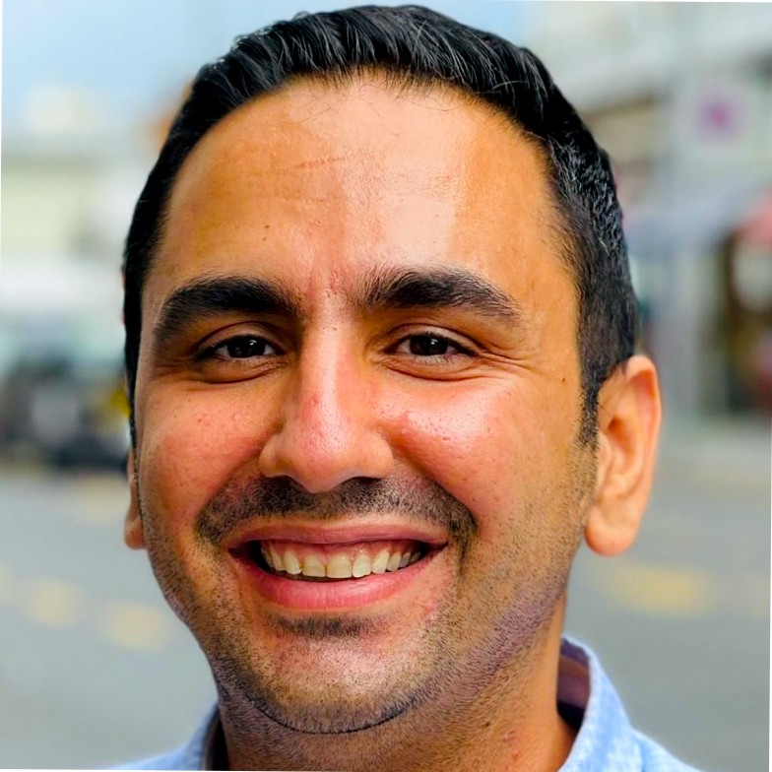

Thank You!
F.BaghaeiNaeini@Kingston.ac.uk
www.fariborz.io

